Slide 1

Let’s talk about Europe...

Slide 2
... And obviously about frosts
Are false springs increasing??
Decreasing??
Is absolutely nothing changing with them?

Slide 4
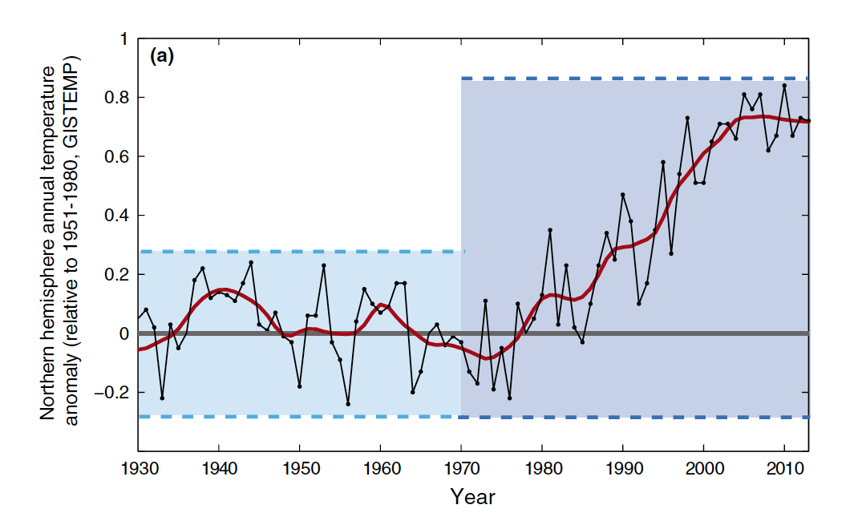

Slide 5
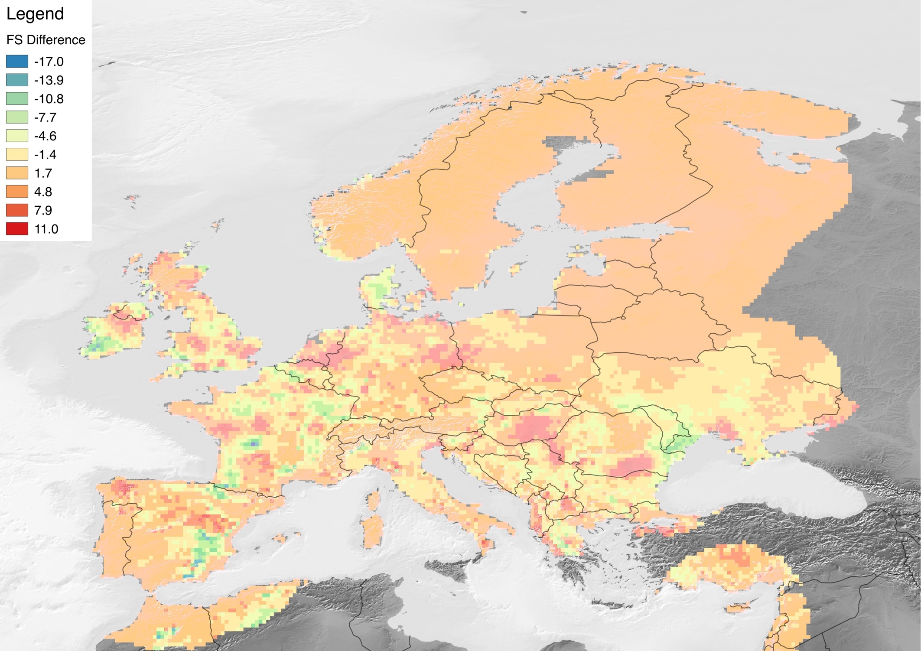
Difference in number of spring freezes after temperature trends increased in the 1980s
Blue/Green: More after the 80s
Red: less after the 80s

Slide 6
Depends on location of study apparently...
What are scientists looking at?
Mean Spring Temperature
Elevation gradients
Latitudinal gradients
So then what are we missing???
Distance from the coast!!
North Atlantic Oscillation Index
EVERYTHING COMBINED!
Notes:
Affects the location and intensity of the North Atlantic jet stream, which results in large-scale shifts in temperature and precipitation. Positive: above-normal temps and precipitation in eastern and northern Europe and below-normal temps in Greenland and sometimes southern Europe and below-normal precip in central/southern Europe

Slide 7
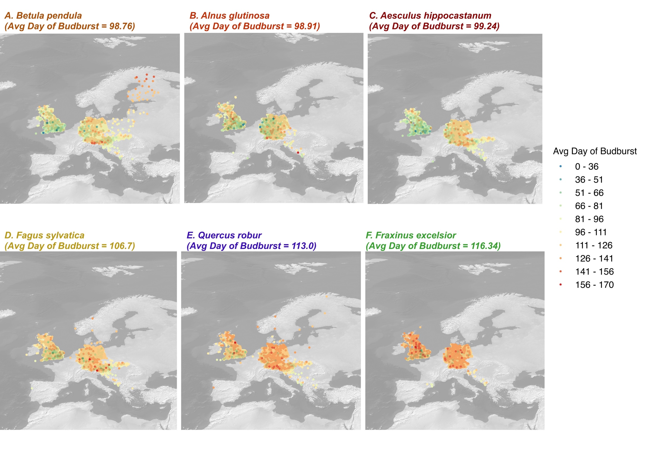

Slide 11
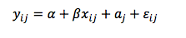
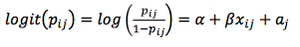
Ma, et al. paper
METHODS
Our Paper
PEP 725 data:
6 species
11648 sites
66 years (1950-2016)
Leaf out data
Climate Data: E-OBS
Parameters:
NAO
Mean Spring Temperature
Elevation
Distance from Coast
Climate Change
Species
Model:
Num FS ~ nao.z + mat.z + dist.z + space.z + elev.z + cc.z + species + mat.z:species + dist.z:species + space.z:species + elev.z:species + cc.z:species + mat.z:cc.z + dist.z:cc.z + space.z:cc.z + elev.z:cc.z
PEP 725 data:
27 species
5565 sites
63 years (1950-2013)
First observation till July 15th
Climate Data: E-OBS
Parameters
Elevation
Distance from Coast
Species
Advancing
Models: random slopes for site; random intercept for species

Slide 12
Ma, et al. paper
RESULTS
Our Paper
Earlier BB species were more susceptible to frost risk
Ditto.
No major effect from NAO
Reduced risk of frost in warmer regions
Reduced risk overall with climate change
Earlier BB species had increased probability and severity of frost risk
More coastal regions had increased probability and severity of frost risk over time, whereas high elevations had lower risk
Advancing spring phenology decreased slightly over time with increasing elevation but LSF advanced significantly – less risk at higher altitudes with climate change
No change in sensitivity analysis – results were the same

